Slide 1


“Detecting bipolar magnetic region in sun using AI/Ml”
By: Mr. Yashwardhan Sable Under the supervision of: Dr. Bidya Binay karak Department of Physics (IIT BHU)
Notes:
Alt + shift + f5

Slide 2
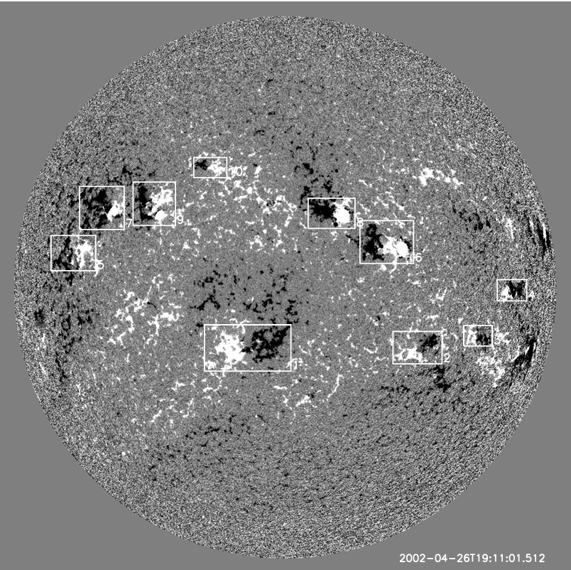
Objective
We will be training a U-Neural Network to find Bi Polar Magnetic Regions in Michelson Doppler Imager Magnetogram.
Bipolar magnetic regions in Magnetogram

Slide 3

Bipolar magnetic Regions
Bi-magnetic regions on the Sun are areas where the magnetic field shows a distinct bipolar characteristic. These regions are primarily associated with sunspots, which are areas on the Sun's surface (or photosphere) that are cooler and less luminous than the surrounding areas. Sunspots are the visible indicators of the Sun's magnetic field lines piercing the photosphere.
Notes:
So just to give an example of how disruptive solar flares can be, the Carrington Event of 1859, which produced auroras visible as far south as the Caribbean and disrupted telegraph networks across Europe and North America. In 1989, a solar storm caused a nine-hour blackout in Quebec, Canada, affecting six million people. In 2003, a solar flare disrupted communication systems and caused the shutdown of a nuclear power plant in Sweden.

Slide 4
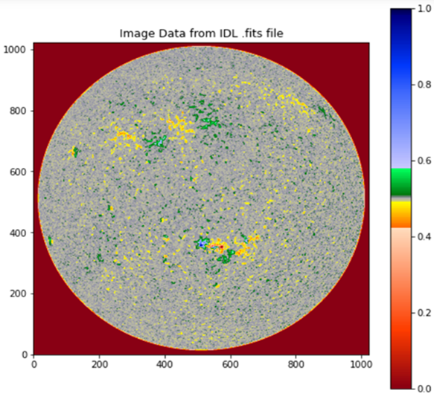
Causes
Solar Dynamo Mechanism: The primary cause of bi-magnetic regions is the solar dynamo, a process where the Sun's rotating, convecting, and electrically conducting plasma generates and maintains its magnetic field.
Differential Rotation: The Sun's differential rotation, where the equator rotates faster than the poles, stretches and twists the magnetic field lines, contributing to the formation of distinct magnetic poles in these regions.
Emergence of Magnetic Flux Tubes: Magnetic flux tubes, formed deep within the Sun's convection zone, rise to the surface due to magnetic buoyancy. When these tubes breach the photosphere, they create areas of concentrated magnetic field, manifesting as bi-magnetic regions.
Notes:
As these charged particles move (mainly electrons and protons), they generate magnetic fields, which can become twisted and tangled due to the rotation of the Sun. When the magnetic fields become twisted enough, they can suddenly snap and release their stored energy in the form of a solar flare. The energy released by a solar flare is in the form of high-energy particles, radiation, and electromagnetic waves, which can travel through space and affect the Earth and other planets. Solar flares are most common during the active phase of the Sun's 11-year solar cycle, which is characterized by increased magnetic activity and the appearance of sunspots on the Sun's surface.

Slide 5
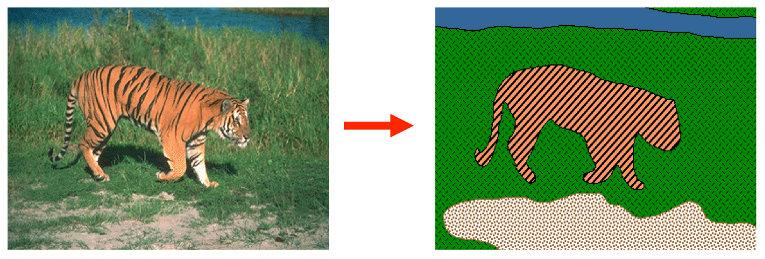
Image segmentation
Identifying BMRs in MDI magnetogram can also be viewed as an image segmentation problem.
Notes:
So in this ug project, we hope to classify whether the flares will happen or not in the next 24 hr seeing the sunspot images and some data points. The number of sunspots on the Sun varies over an 11-year cycle, with periods of high activity (called the solar maximum) and low activity (the solar minimum). During the solar maximum, the number of sunspots increases, and the Sun's magnetic field becomes more complex and active. This is because the magnetic field lines are highly twisted and tangled, making it easier for them to snap and release energy. During the solar minimum, sunspots become less frequent, and the Sun's magnetic field becomes less active and simpler. This is because the magnetic field lines are more stretched out and less likely to snap and release energy.

Slide 6
BMR as image segmentation
Identifying BMRs can be viewed as an image segmentation problem. Basically, we are given an high definition image mdi magnetogram (mdi. fd_M_96m_lev182) and we have to segment the image into bmr and non bmr regions.
We have a total of 3606 hd images of the sun on which we will train our model and 902 images on which we will test
We will train a special type of neural network called a u network to accomplish this task.
Notes:
Classifying solar flares provides valuable information for predicting space weather events. Solar flares are classified based on the intensity of their X-ray emissions. The classification system used to categorize solar flares is known as the "GOES" (Geostationary Operational Environmental Satellite) classification system. The GOES system uses a letter to indicate the X-ray intensity of the flare, followed by a number that indicates its relative strength within that category.
Each category is ten times more powerful than the previous one. For example, an M-class flare is ten times more powerful than a C-class flare, while an X-class flare is ten times more powerful than an M-class flare.

Slide 7
Bmr as image segmentation

Slide 8
Transfer learning
Transfer learning is a machine learning technique where a model developed for one task is reused as the starting point for a model on a second task. This approach leverages the knowledge gained while solving one problem and applies it to a different but related problem.
It's particularly useful in deep learning where training large models from scratch requires significant computational resources and data, making transfer learning a go-to method for tasks like image recognition and natural language processing where pre-trained models can be fine-tuned for specific purposes.
Notes:
Total line of sight unsigned flux refers to the total amount of magnetic flux passing through a given area, without regard to the direction of the magnetic field. The mean gradient of line of sight flux is a measure of how the total magnetic flux passing through a given area changes as a function of position along the line of sight. It represents the spatial variation of the magnetic field strength in the direction of observation. Polarity inversion lines (PILs) are imaginary lines that separate regions of opposite magnetic polarity on the surface of the Sun.

Slide 9
Convolutional neural networks
Convolutional Neural Networks (CNNs) are a type of deep learning algorithm commonly used for image and video recognition tasks. CNNs are designed to automatically extract relevant features from images by applying a series of filters, or convolutional layers, to the input data.
This allows the network to learn increasingly Abstract representations of the data as it progresses through the layers. CNNs have proven to be highly effective in a wide range of applications, including object detection, facial recognition, and medical image analysis. They have also been used to achieve state-of-the-art performance in many benchmark image recognition tasks.
Notes:
It uses filters to basically capture the image. As you can see in the diagram, I have shown the working of one filter of CNN. So basically a filter is multiplied by a section of the image and then added up. So 3 is obtained by multiplying 0*0 + 3*1 + 1*0 and so on

Slide 10
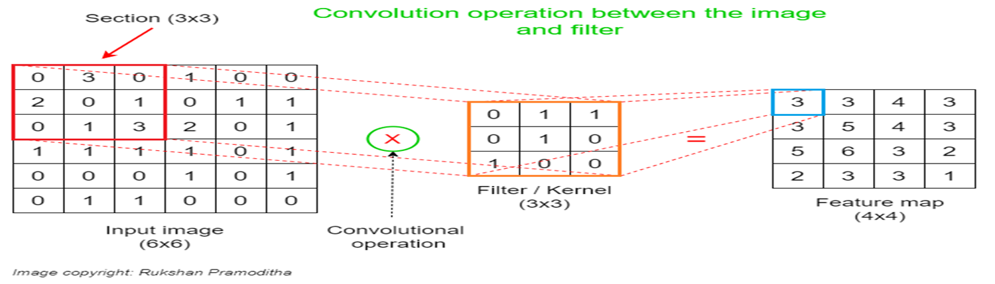
Convolutional neural networks (Cnn)
Notes:
So in previous slide, I showed the working of one convolution filter. But generally these filters are stacked, like shown in the image. So this is how a neural network “sees” the image which is very useful to us as we use image data from cutouts of full-disk line-of-sight magnetograms. A line-of-sight magnetogram is a type of solar magnetogram that measures the line-of-sight component of the magnetic field on the surface of the Sun. This means that the magnetogram records the strength and orientation of the magnetic field as seen from the observer's perspective. There are some other types of magetograms also: like vector magnetic field (whole 3d shape) and transverse magnetic field ( perpendicular to line of sight magnetograms).

Slide 11
U networks
U-Networks, commonly referred to as U-Net, are a type of convolutional neural network designed specifically for image segmentation tasks.
U-Networks architecture, resembling the letter 'U', efficiently enables precise localization and contextual information capture by combining low-resolution, semantically rich layers with high-resolution layers. This structure makes U-Net highly effective in astronomical object segmentation, as well as in other fields requiring detailed and accurate image segmentation.
Notes:
So in simple language LSTM models are used to store long term memory. Like in Neural networks, one of the problems was that it used to forget things that were done long ago. Therefore they made this model to learn long term dependence which is actually very useful in solar data, as we deal with hundreds of years of data.

Slide 12
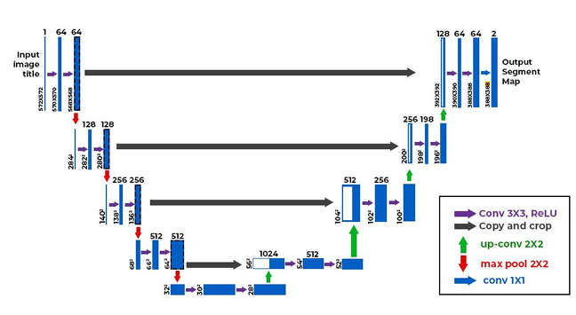
U-networks
Fig – U-Net Architecture

Slide 13
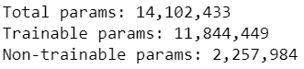
Our model
Our model leverages transfer learning techniques and uses MobileNet V2 network as a base model.
We then train our model upon the base model using U-Net architecture, for image segmentation to produce a 1024X1024 Mask.
Then the mask is compared with the true mask that we have obtained analytically and the error signal is propagated backwards.
Notes:
Here p_{i} and q_{i} are the predicted probability by LSTM and CNN, respectively, and α is the meta-learner parameter. The meta-learning of the stacking ensemble essentially means finding the optimal combination weight α. To that end, we minimize a loss function that penalizes the difference between the prediction r_{i} and the binary label y_{i} ∈ {0, 1} for samples in the validation set.

Slide 14
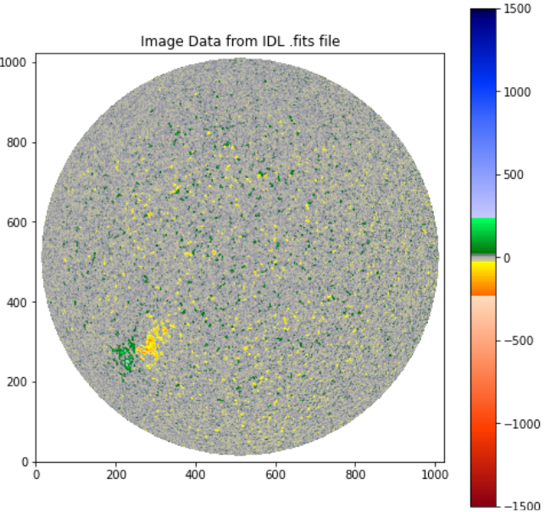
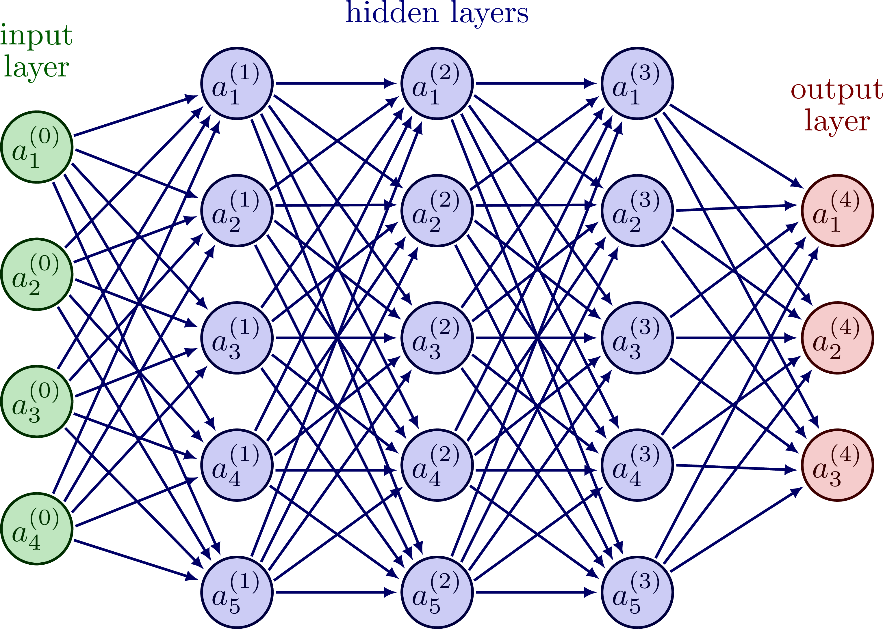




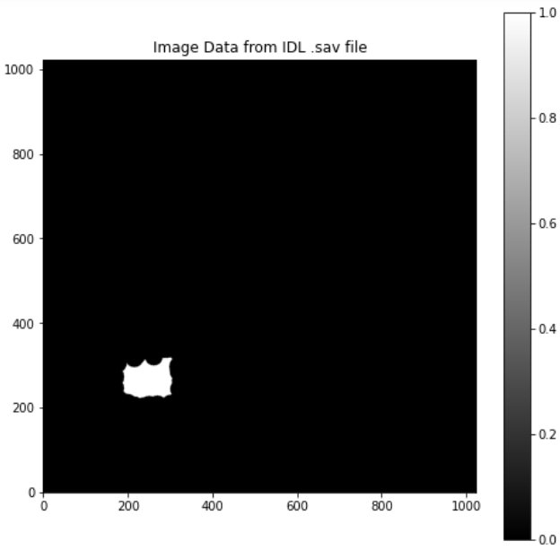

Architecture flow
Image
Transfer Learning
U Networks
Loss
Mask
Notes:
Like this is the model architecture that I am trying to reproduce.

Slide 15
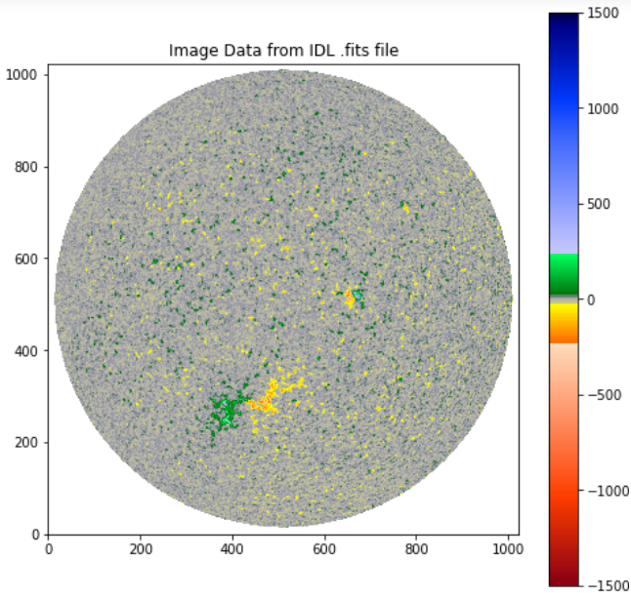
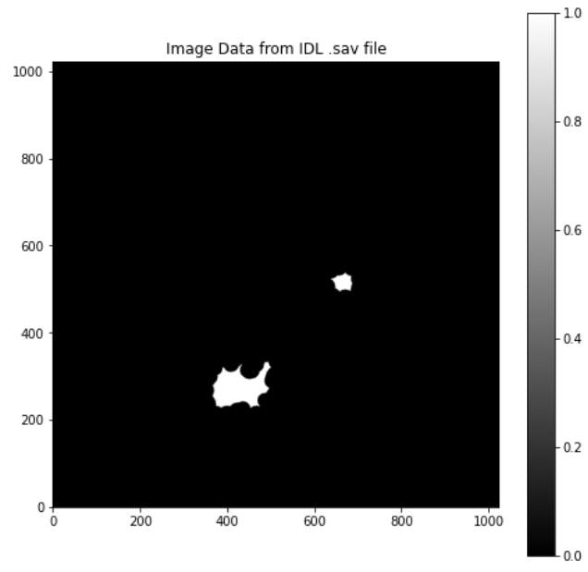

Final working
Trained Model
Input Image
Output Image

Slide 16
Limitations of our approach
The main limitation of our approach was that it was very computationally expensive. A single epoch of the training run took around 30 minutes on a GTX 1650Ti graphic card.
Another limitation encountered was that our process was very data dependent. This was because our training set was hand curated using analytical techniques. Therefore any mistakes in the data would be propagated to the model itself.

Slide 17
Final comments
Using Machine Learning Models is very useful in a data intensive field such as solar astronomy.
Our model serves as a basic checkpoint against which further approaches to the open research problem of finding exact count of BiMagnetic Regions in a magnetogram can be worked upon.
This model serves as a proof of concept for usage of machine learning and statistical techniques in data intensive field of astronomy.
Thank You!

